Slide 1
Making an asthma diagnosis

Slide 2

Asthma
Chronic inflammatory disease of airways
Variable
  different for different people
  different in the same patient at different times
  different types of exacerbations

Slide 3


Slide 4


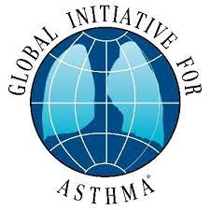


Slide 6
  Diagnostic conundrum…Asthma should have objective testing
  BUT no diagnostic tests in < 6yrs
  limited access to spirometry
  Technique dependant
  Can be normal (particularly in children)
  Many children with uncontrolled asthma have normal lung function between exacerbations
Notes:
positive bronchodilator response - evidence of reversibility increase in FEV1 >12% predicted
measure change 10-15 minutes after 2 puffs - 4 puffs salbutamol
can do this with peak flow too
can withhold LABA or SABA prior to testing to optimise chances of response
variability in peak flow >13%- calculate from twice daily PEF days highest-days lowest divided by means of days highest and lowest) x 100 then average of each day’s value calculated over 1-2 weeks
predicted normal rages have limitations so use patients personal best as their normal
PEF can vary by 20% between different meters

Slide 7
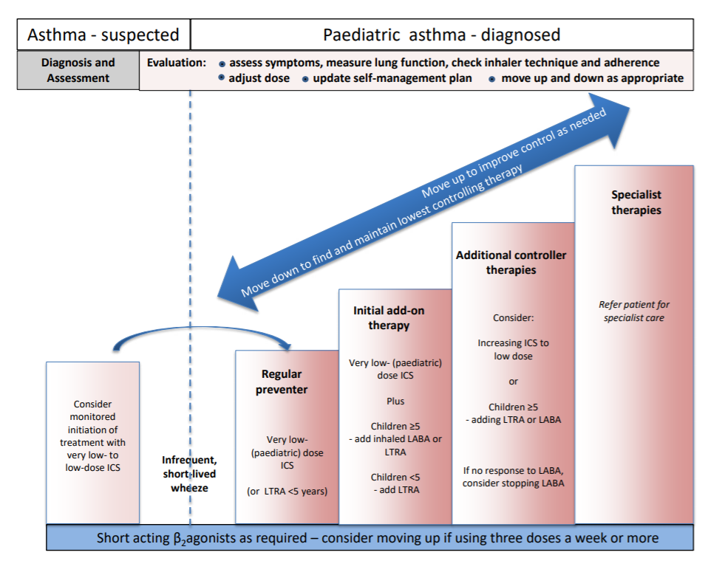
BTS/SIGN Management

Slide 8
Asthma making a diagnosis clinically
Symptoms: wheeze, cough, breathlessness, chest tightness
Structured clinical assessment (from previous medical records)
  recurrent episodes of symptoms “multitrigger wheeze”
  symptom variability
  recorded observation of wheeze
  personal history of atopy
  preterm, LBW, greater infant weight gain
  (historical record of variable PEF (or FEV1) - if able to do testing – usually unable < 5-6yrs)
  absence of symptoms of alternative diagnosis

Slide 9
Still not sure? Is it asthma?
Prescribe a bronchodilator + spacer to those with wheeze
If recurrent - trial of preventative treatment is reasonable
  Review after 6-8 weeks
  Did daytime and night time symptoms improve
  Has PEFR improved
  Stop and reassess

Slide 10
7 yr old M
Hayfever & recurrent croup
Previous admission with viral induced wheeze aged 3
Previous Clenil 50mcg BD by GP but not taking for some years
ED attendance in Jan with croup, wheeze documented
Admitted to ward with exacerbation of wheeze
No nocturnal cough, sometimes limitation on play but symptoms mostly with viruses
FHx atopy, exposed to cigarette smoke at home
Is this asthma?
What should we start him on?

Slide 11
Always revisit the diagnosis
15y F diagnosed asthma aged 8, treatment progressively escalated
Chronic cough
Hayfever
Never wheezed, no steroid course, no ED/admissions, no acute exacerbations of cough
Normal PEFR, no variability, normal FENO, normal spirometry

Slide 12
Asthma/wheeze - when to refer to Paeds…
Diagnosis unclear/diagnostic uncertainty
Poor response to asthma treatment
Red flags
  Failure to thrive
  Unexplained clinical findings
  Symptoms present from birth
  Excessive vomiting
  Severe URTI, persistent wet cough
  Nasal polyps
  FH Chest disease
Notes:
these ay be LB/IUGE children who have had excessive catch up growth

Slide 13
What do we mean by “poor response?”
Not maintained on low/mod dose steroids
2 attacks in 12 months
Any admission to hospital with asthma
Please check
- inhaler technique
- education

Slide 14
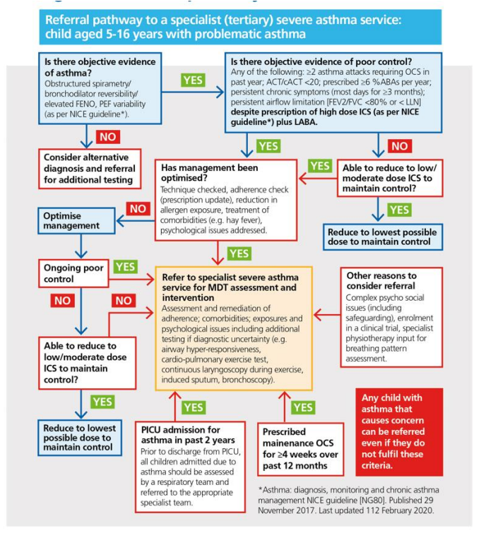
Life threatening asthma/PICU admission
> 4 weeks oral steroids/year
Poor control on high dose ICS + long acting B agonist (BTS step3)
  > 2 courses OCS/year
  >6 salbutamol previous year
  FEV1 < 80%
  ACT < 20 or symptoms most days

Slide 15
Asthma management – what are we aiming for?
Good symptom control
Minimise risk of asthma attacks and asthma death
Avoid treatment side effects
Agree goals with CYP/family and work in partnership towards this

Slide 16
Exclude alternative diagnoses Symptom control & modifiable risk factors
Comorbidities
Inhaler technique & adherence Parent preferences and goals
Symptoms Exacerbations Side-effects Parent satisfaction
Global Initiative for Asthma (GINA) 2021
Notes:
Is it asthma? If so is it coded correctly?
Education
Trigger avoidance
pollens, indoor & outdoor pollutants, weather
Co-morbities
allergic rhinitis, obesity, stress & anxiety
Written PAAPS

Slide 17
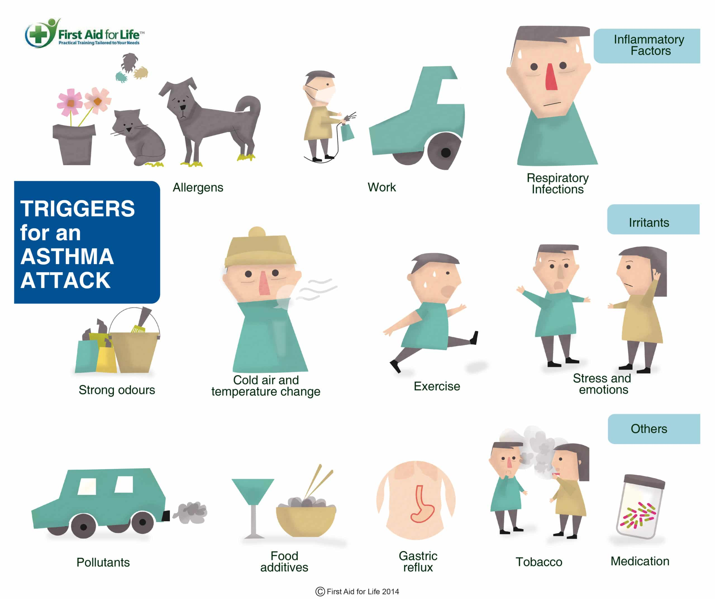
Trigger avoidance

Slide 18
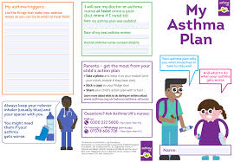
Trigger avoidance/management
Pollen forecast - Met Office
London Air Quality Network Air Quality Forecast for London
Smoking cessation
Antihistamines
Nasal sprays
Breathing techniques
Healthy eating

Slide 19
Treating allergic rhinitis improves asthma control
Correct nasal spray technique
Notes:
AR - nasal congestion with mucus, oedema and polyps, tonsillar and adenoid enlargement, decrees nasopharyngeal area, OSA
airway hyper responsiveness and variable airflow obstruction
aR intermittenet or persistent driven by a hypersensitive allergic reaction to an allergen such as pollen
stimulation of upper airways can lead to inflammation in the lower airways

Slide 20
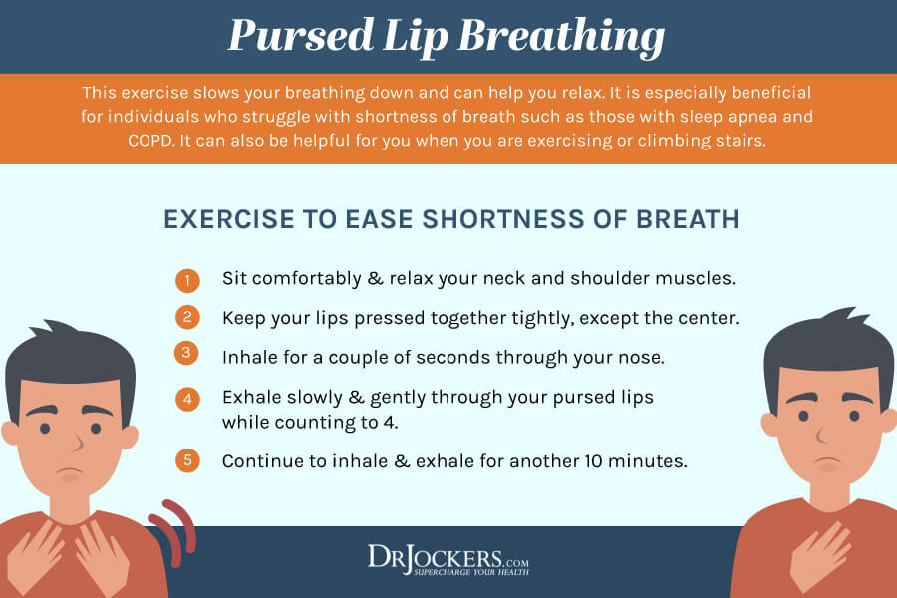

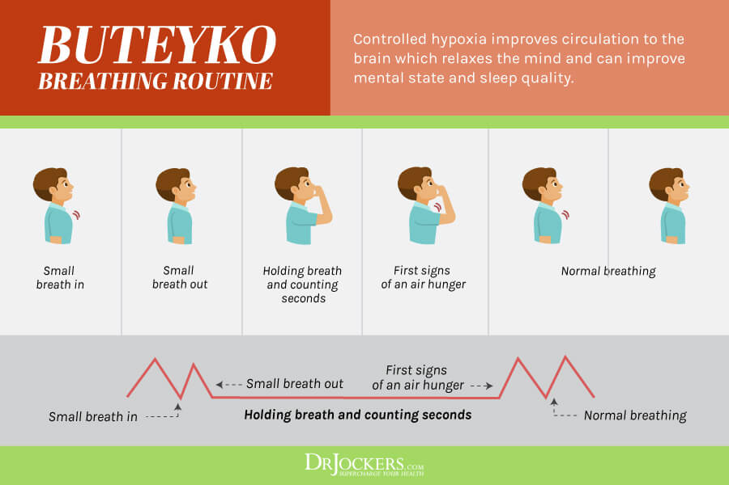

Slide 21
Pharmacological treatments
Inhaled corticosteroids
Bronchodilators - short acting or long acting in combination with ICS
Leukotriene receptor antagonists
Oral steroids
Biological therapies
Allergy management

Slide 22
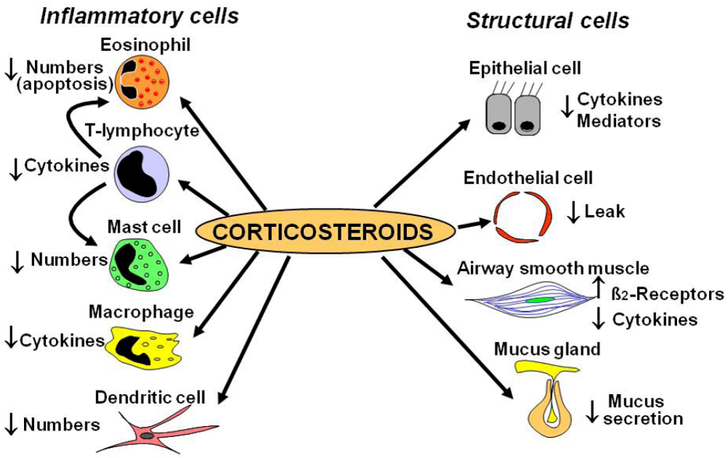
ICS
Delivery directly to the lungs/airways reduces systemic absorption thus reducing the risk of side effects compared to oral corticosteroids

Slide 23
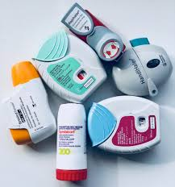
Not all ICS are the same
Dosing across all products is not equivalent, prescribe by brand name
TDD Clenil
•Very (paediatric) low dose 100-200mcgs
•Low dose 200-400mcgs
•Medium dose 400-800 mcgs
•High dose not recommended
Clenil 50mcgs 2 puffs BD = Very Low dose
Flixotide 50mcgs 2 puffs BD = Low dose
Qvar50mcgs 2 puffs BD = Low dose
(BTS/SIGN 2019)

Slide 24
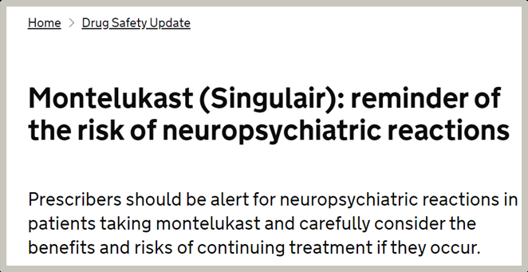
Montelukast
Anti-inflammatory effect
•Oral medication
•Add on therapy in asthma
•Option to use as only preventer treatment in children under 5 years of age
•Can treat allergic rhinitis
•Not as effective as ICS or intranasal CS

Slide 25
Before modifying treatment
Check adherence with ICS
-address if not taking as prescribed
•Check inhaler technique
-address if incorrect
Review other modifiable factors
-triggers

Slide 26
Adherence is the BIG ISSUE
Non intentional
forgetfulness
chaotic schedules
poor understanding
mental health issues
social barriers
co-morbidities (confusion/priorities)
The rate of non-adherence for asthma treatment is between 30-70%
Intentional
fears about side effects
misconceptions
health beliefs
denial of asthma
stigma

Slide 27
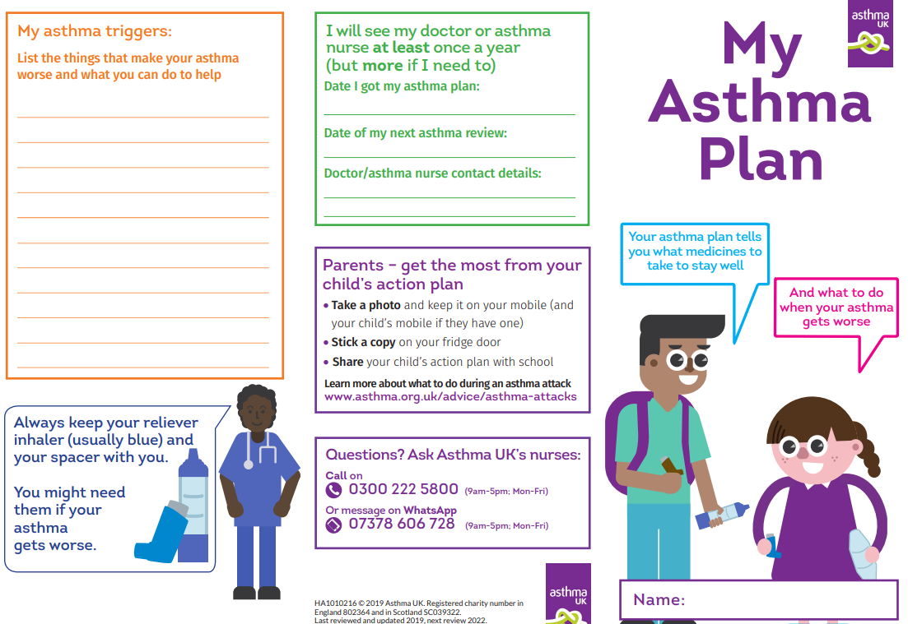
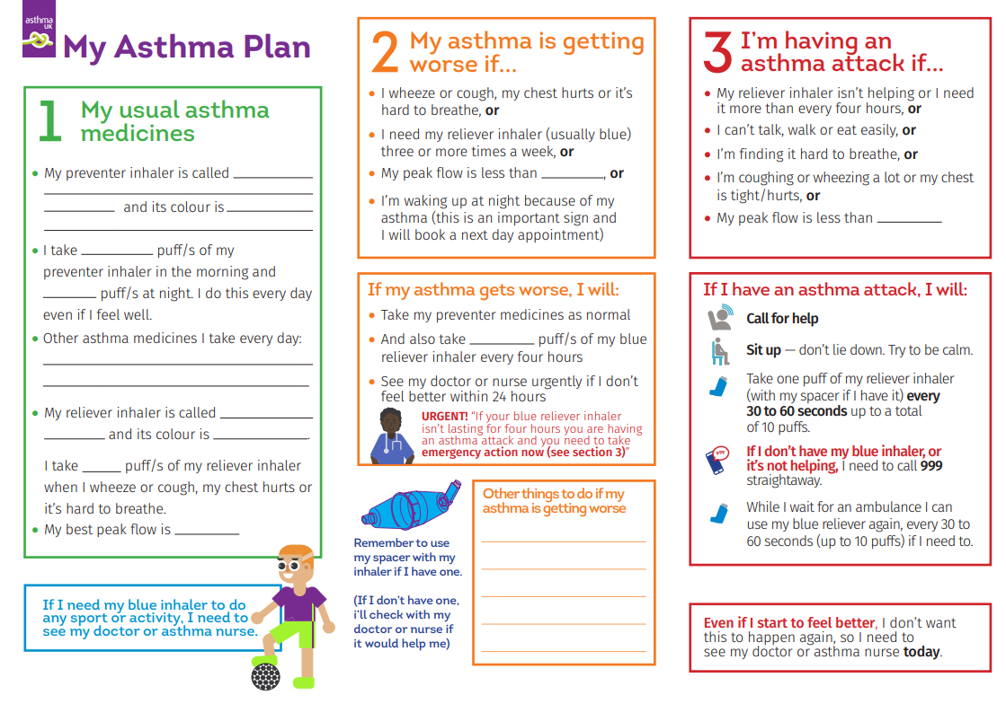

Slide 28
Inhaler technique
Demonstration
Coaching
Effect wanes over time
Review and reinforcement at every encounter
Alongside education, training videos are effective for supporting correct inhaler technique

Slide 29
https://www.asthma.org.uk/advice/inhaler-videos/child-no-facemask/

Slide 30
Common errors
Not preparing the device correctly
Not loading the dose correctly
Not exhaling fully before delivering the dose
Not lifting the chin before inhaling the dose
Incorrect inspiratory flow rate
Poor coordination between actuation and inhalation
Not holding the breath after a dose (if breath and hold or DPI)
Incorrect spacer

Slide 31
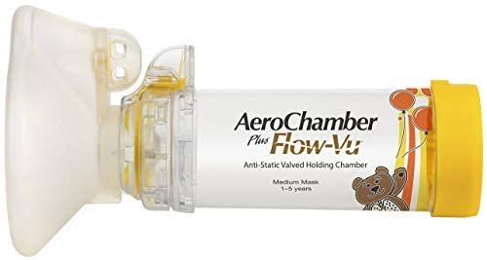
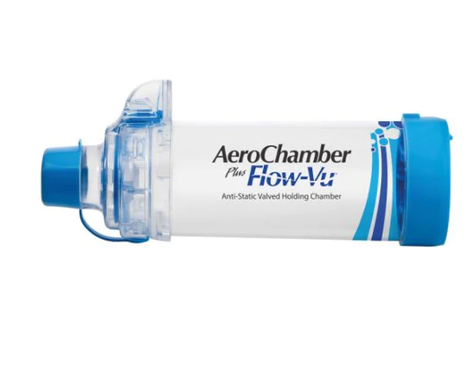
At every review
Check adherence with ICS
  practical ways to remember
  dose counters
  prescription requests
Check inhaler technique & correct age spacer
Review other modifiable factors
1- 4yrs
4 yrs +

Slide 32
Post attack review
Two aims - Getting better? Reflection on attack
Sudden or gradual onset
Obvious trigger? New or known
Did they recognise symptoms and act appropriately
When did they realise they were in trouble
Is there an appreciation of severity of attack
Risk of future attacks

Slide 33
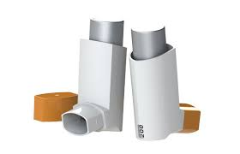
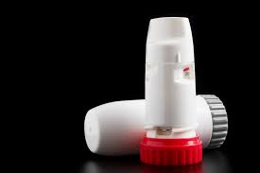
pMDI inhalers are aerosol based formulations contained within a pressurised canister that delivers a metered dose of medication at high speed once activated
DPI inhalers are powder based formulations that require a forceful inhalation to break the powder down into fine particles and propel them from the device
The greenest choice is asthma that is well controlled

