Slide 1
Teenagers and Asthma
What GINA means for me?

Slide 2
Case
13 yr old 2-3 x month symptoms
ACT 20/25
No attacks on past year
Clenil 100 1 puff and salbutamol as rescue
Do you ?
Stop regular beclomethasone, SABA only symptom relief
Stop regular beclomethasone and use when SABA needed
Change ICS-formoterol use only when symptomatic
No change
Notes:
Stop regular beclomethasone, SABA only symptom relief
Stop regular beclomethasone and use when SABA needed – practically most wont carry 2 or remember to take ICS after
Change ICS-formoterol use only when symptomatic
No change – some evidence that do better if take daily but if not many symptoms what are the child and parent goals

Slide 3
Option 3: Anti-reliever strategy
Good evidence in adolescents that ICS-formoterol is an effective reliever (either as needed or in combination with maintainence ICS-formoterol)
Need correct technique for DPI
MART specific asthma plan
Licensing issues
No need to rinse mouth after rescue doses
Good pre exercise – greater reduction with formoterol compared to salbutamol
All evidence is budesonide-formoterol. Do not use as reliever with other ICS-LABA (e.g. no Seretide maintainence and Symbicort reliever)
Notes:
Good evidence for ICS –formoterol – in UK Budesonide which exists as DPI turbohaler or at 100/3 MDI for spacer use
Formoterol is a quick onset long acting beta agonist

Slide 4
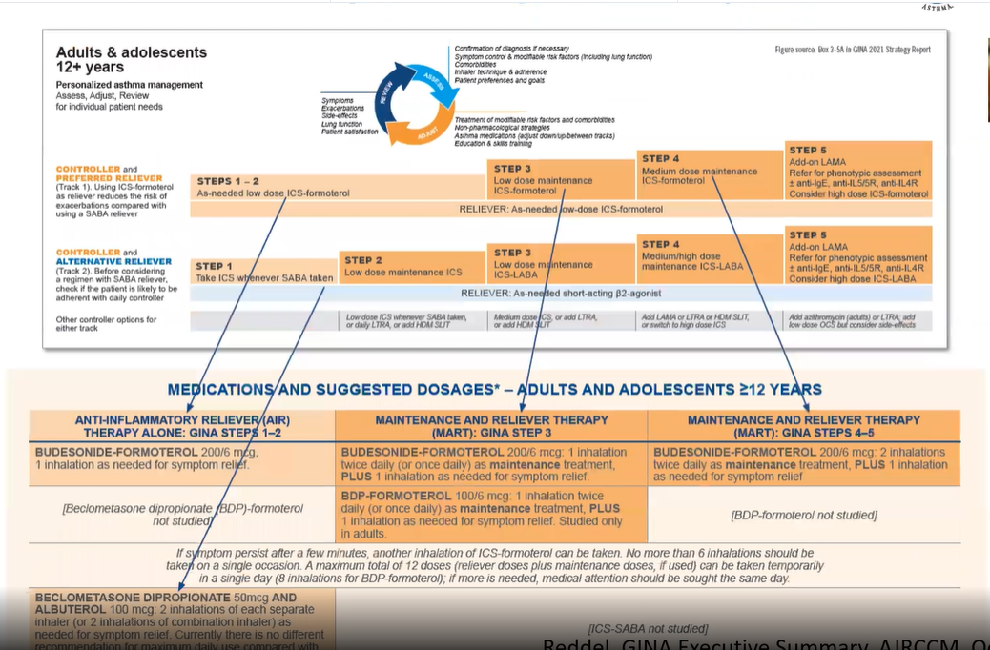

Slide 5
Doses
Anti-inflammatory reliever
MART
Dosing of as needed Budesonide-formoterol 12 +(Step 1-2)
  Usual dose 200/6 mcg; 1 inhalation whenever symptoms
  Maximum daily dose (temporarily) 12 inhalations
  If >8 inhalations a day seek medical review
  Maximum 6 inhalations at one time
  Average use from trials 3-4 doses/week
6 yrs +
  Clenil 100mcg taken whenever using SABA 2 puffs
Budesonide-formoterol doses 12+
  200/6mcg one inhalation twice daily (Step 3) two inhalations BD (Step 4&5)
  Reliever & maximum doses as AIR
Dosing budesonide-formoterol for MART (4-11 yrs)
  100/6 inhalation once daily (Step 3); 2 puffs BD (Step 4-5 yrs)
  Maximum 8 daily doses
  Maximum 4 inhalations at one time

Slide 6
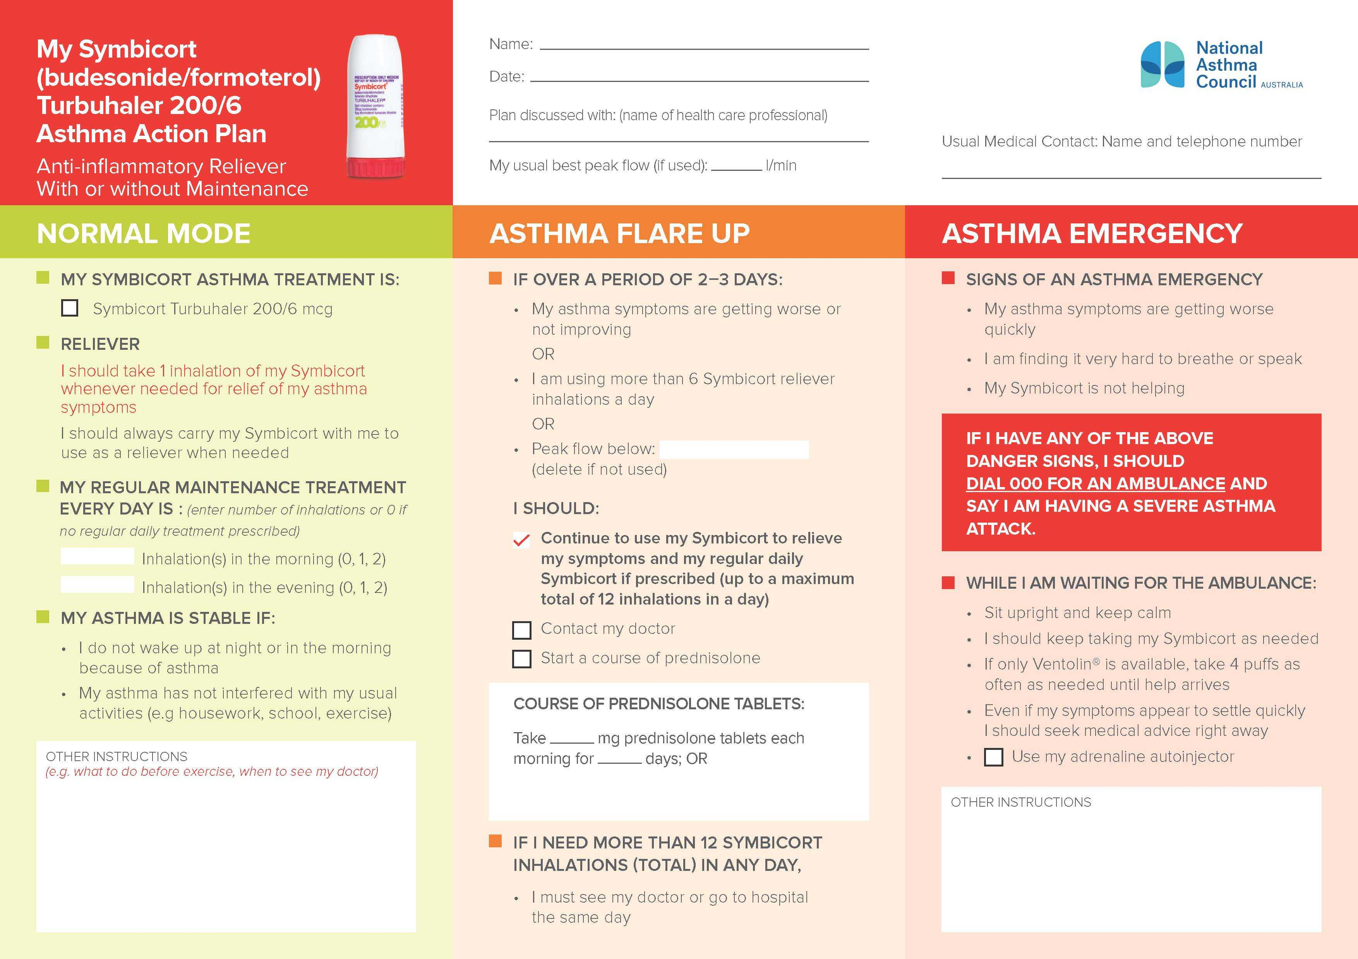
Notes:
Age dependant number of maximum puffs

Slide 7
Stop regular beclomethasone, SABA only symptom relief – least effective and increases risk of exacerbation
Stop regular beclomethasone and use when SABA needed – practically most wont carry 2 or remember to take ICS after
Change ICS-formoterol use only when symptomatic
No change – some evidence that do better if take daily but if not many symptoms what are the child and parent goals and do they have the technique?

Slide 8
Open conversations about adherence
Understanding of asthma, inhalers and attack risk
What would they do if away from home and had symptoms/relief from SABA not lasting 4 hours
Young person needs to know signs/symptoms asthma control getting worse
Treat allergic rhinitis. Non sedating antihistamines. Correct nasal spray technique
If OD regimen but would need to stronger formulation
Trigger avoidance (particularly pollen)

Slide 9
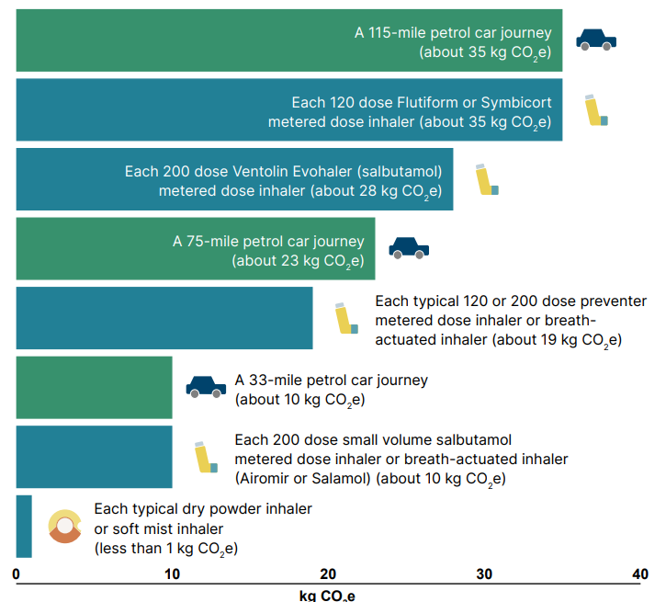
Environment
Best choice is controlled asthma
Do you tell patients to take old inhalers to pharmacy for disposal?
Salamol v Ventolin
Use NICE inhaler decision aid to engage patient in decisions about treatment

Slide 10

Moving to DPI
Technique
Technique
Technique
MART regimens
Can they activate the inhaler during an attack?
Different PAAPs
No Salbutamol

Slide 11
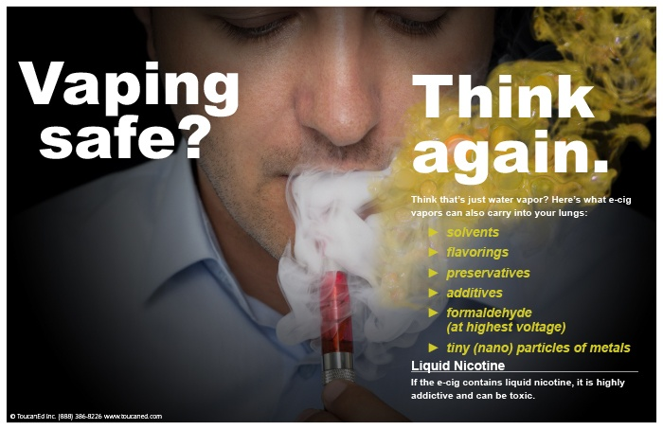

Slide 12
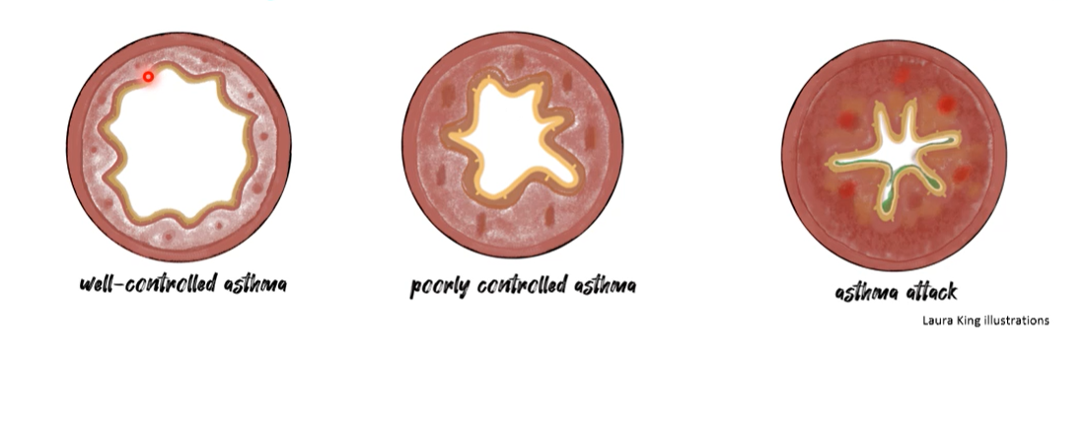
Often lack of understanding of asthma as an inflammatory condition
1
2
3
Going well
Don’t stop preventor because feeling better
Meet a trigger, unwell with cold, getting wheezy
If sitting at no2 as baseline, more likely to go to red, angry lungs = asthma attack, need to seek help

Slide 13
Airway inflammation not just asthma
Atopic conditions particularly hayfever
One airway concept – if nose is inflamed it will affect chest
Stress/anxiety is a pro-inflammatory – exam time, life stresses
Obesity – existing in pro-inflammatory state
Notes:
Do worse in exams if hayfever undtreated

Slide 14
Toxic trio
Persistent symptoms
Previous attacks
Suboptimal treatment regimen

Slide 15
Salbutamol use
3 canisters per yr = high risk ED presentations
>12 (average 6 puffs a day) higher risk of death
Beta receptor downregulation, rebound hyperresponsive, decreased response
Increased allergic response, increased eosinophilic airway inflammation
Inducement of proinflammatory pathways
Notes:
(365324 pts 12-45 yrs in Sweden at all treatment steps)

Slide 16
Technique
Understanding
Individual goals
Treat atopy
Psychological or mental health issues (parent or child)
Correct coding
Avoid SABA only & keep track of no. SABA inhalers

